Slide 1

e-Platform Team And Project Introduction
Fan Liao

Slide 2
Agenda
Team Structure
Roles and Responsibilities
Work Flow
e-Platform Project
Current Tasks

Slide 3
Team Structure
Jasper Hur
Jam Zhang
Sean Li
Kyanite Liu
Kate Li

Slide 4
Roles & Responsibilities
Role | Members | Responsibilities
PM | Jasper | Planing and Scheduling Requirement Study and Analysis Reporting Code review UAT support
Developers | Jam, Kyanite, Sean, Kate | Development SIT testing Document
QA | Angel?

Slide 5
Work Flow
Nomura
PM
Developer
New Project
Requirement Study and Estimation
New JIRA
Development
Func Spec
Unit Test
Code Review
SIT
UAT

Slide 6
e-Platform Project
e-Platform is an application that presents portfolio positions, transactions and account information over the Web with e-Platform.
Client can view and analyse entitled portfolio online and access latest market data and announcements from Nomura.
Notes:
Can user see saved order?

Slide 7
Out of Scope
Client's sensitive information will not be displayed in WMD e-Platform, such as client names, addresses, etc.
Notes:
Can user see saved order?

Slide 8
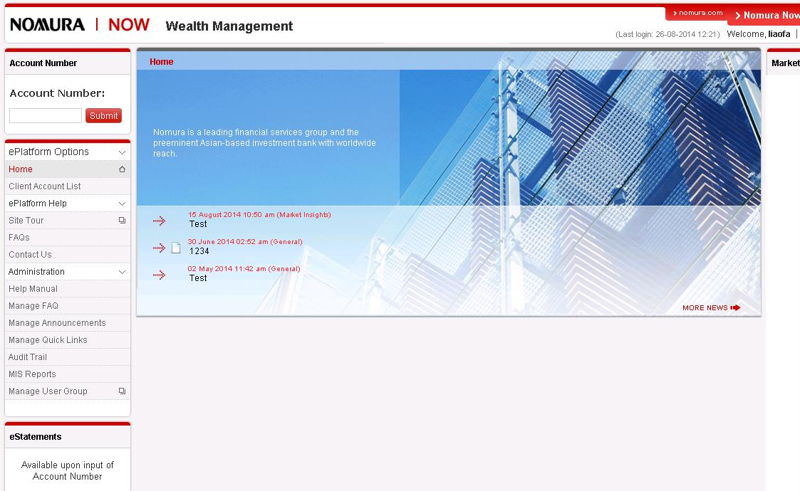
e-Platform for desktop

Slide 9
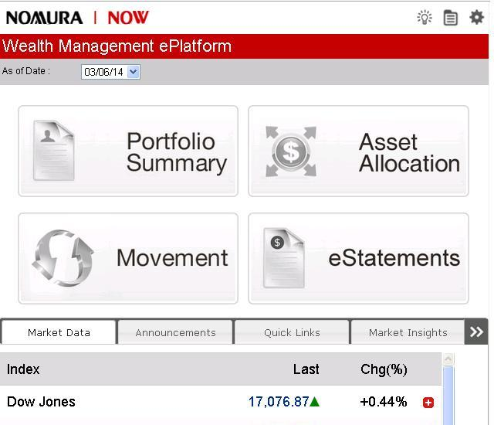
e-Platform for mobile

Slide 10
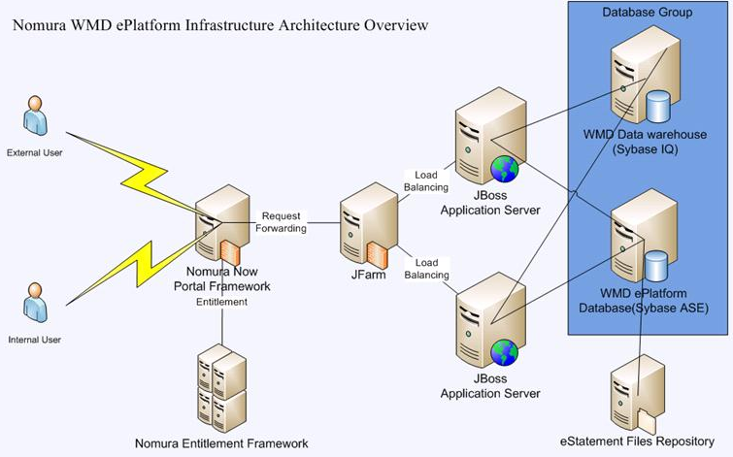
e-Platform Architecture
Notes:
Need ADP5 explain the details of each line
Is it a avaloq script or sql script
Provide the script of create order. ELN by using the dumpy asset type

Slide 11
e-Platform Users (1)
- Client: External user who navigates portfolio which belong to the client
- RM: Internal user who navigates client portfolio which are entitled to him/her
- CSO: Internal user who navigates client portfolio which are entitled to specific sales teams
- BMO: Internal user who navigates client portfolio of specific location(s)

Slide 12
e-Platform Users (2)
- Admin1/Admin2: Internal user who is responsible for maintaining the e-Platform content of announcement, quick access link, FAQ
- Report Viewer: Internal user who has right to navigate the e-Platform usage data and audit trail
- RTB: Internal user who is responsible for user registration and management of WMD e-Platform
- Super User: Internal user who is able to access all functions in WMD e-Platform

Slide 13
e-Platform Portfolio Modules
- Client Account List
- Portfolio List
- Portfolio Summary
- Asset Allocation

Slide 14
e-Platform Position Details (Product Type)
- Money Account
- Bonds
- Equities
- Equities (SBL)
- Funds
- Structured Products
- Derivatives
- Others
- Securities Movement
- Deposit & Loans
- Forex
- Cash Movement

Slide 15
e-Platform Admin Modules
- Manage FAQ
- Mange Announcements
- Manage Quick Access Links
- Audit Trail
- MIS Report
Manage User
Client Corresponding (New in 2017)

Slide 16
Q & A
Any Questions?

